Slide 1
Data Catalog
DAPD Benson Wu

Slide 2
What’s Data Catalog ?

Slide 3







Data management for big data and self-service analytics
Easy to find
Understand data
Manage
Data Catalog

Slide 4
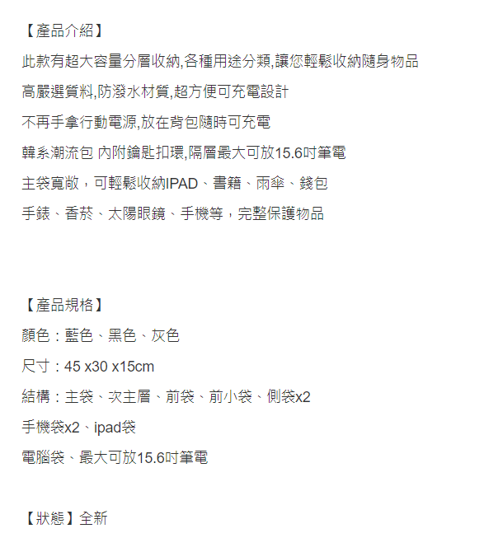
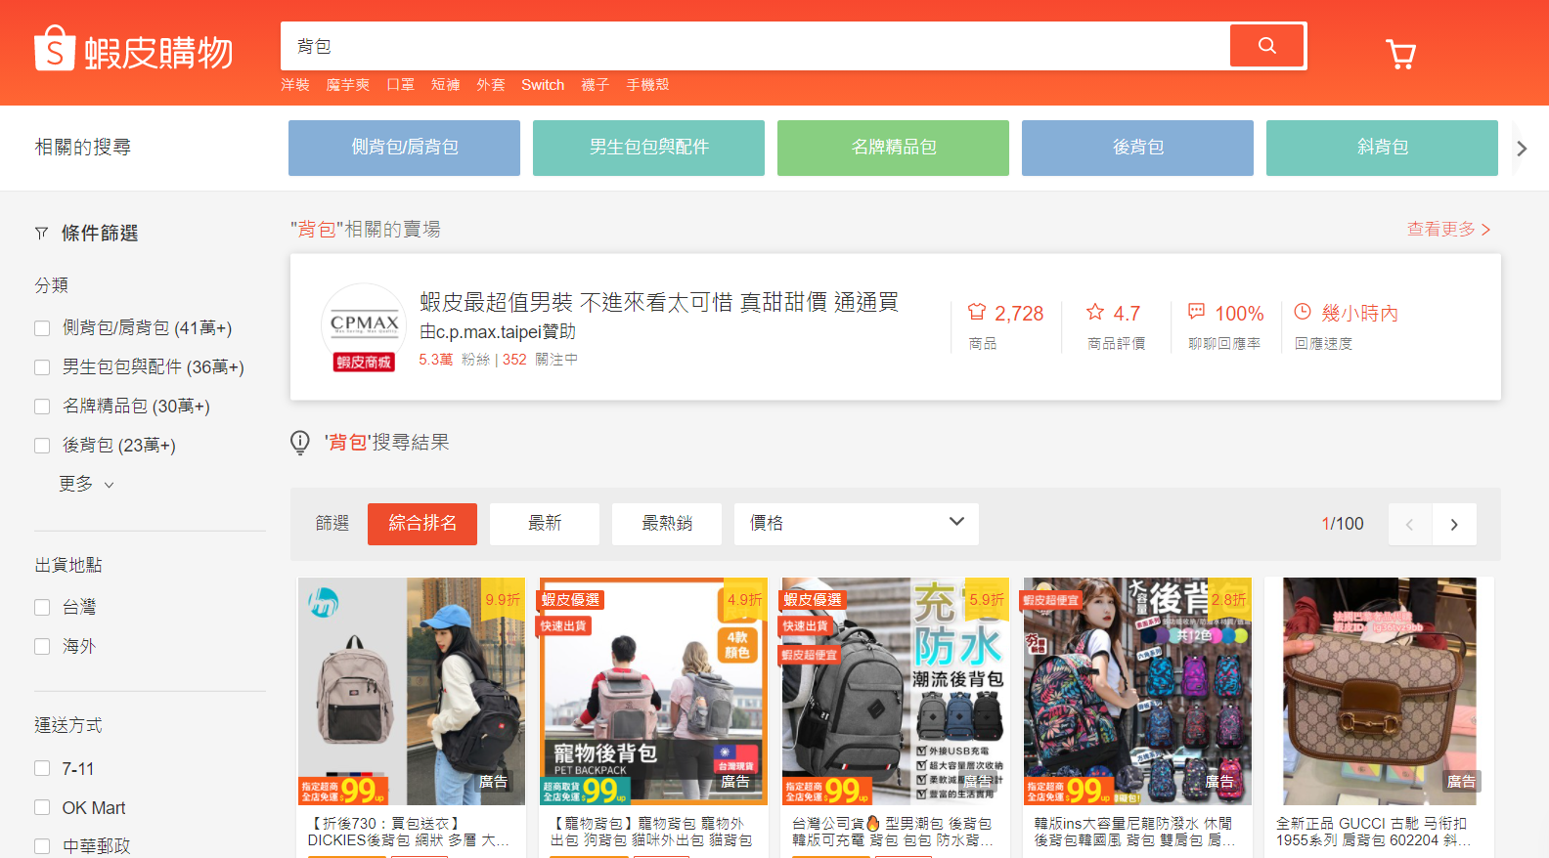

Slide 5
Why need data catalog ?

Slide 6
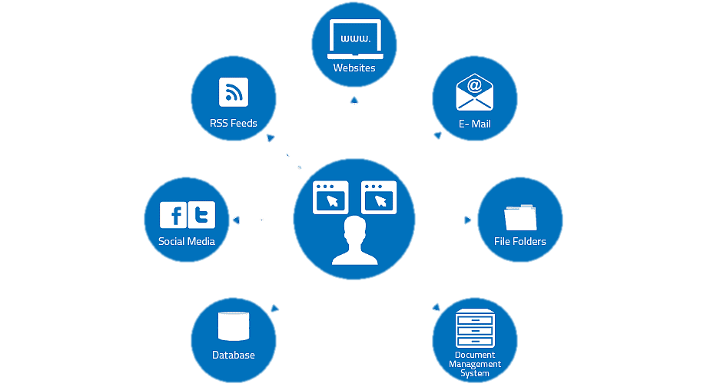
Big Data
Notes:
資料產生的量與種類越來越多，要了解的內容也相對變多且複雜
這些資料哪裡來的 誰在使用?

Slide 7
Self-service analytics
Discover
Understand
Contribute
Consume
Time Spent
Notes:
How much time to take data into business insights like data engineers / scientists ?
我應該要怎麼提供一個好的服務去改善現況，減少取得數據的時間，讓想要資料的人可以專注在資料上
大家對於資料的認知不同 IT想知道如何去使用資料 \ Business想知道這些資料代表的是什麼

Slide 8
Risk Management & Compliance
Risk
Monitor
Risk
Mitigation
Identify
Who has access to sensitive data?
How can I secure the sensitive data ?
Notes:
透過取得資料的發展，風險與安全性也顯得相對重要
需要了解那些數據是比較敏感的，該怎麼監控或保護?

Slide 9
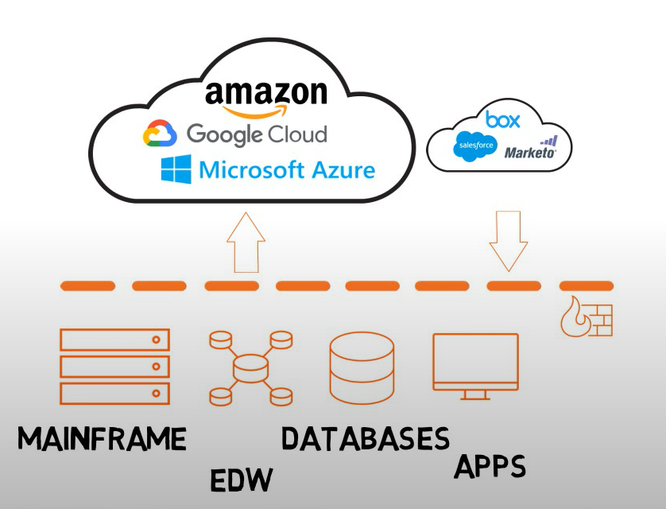
Cloud Migration
Notes:
怎麼利用雲端服務幫助公司轉型
方便控管 又能確保Application放上雲端依然可以執行順利?
EDW (Enterprise Data Warehousing) 倉儲
Mainframe 大型電腦

Slide 10
Google Data Catalog

Slide 11
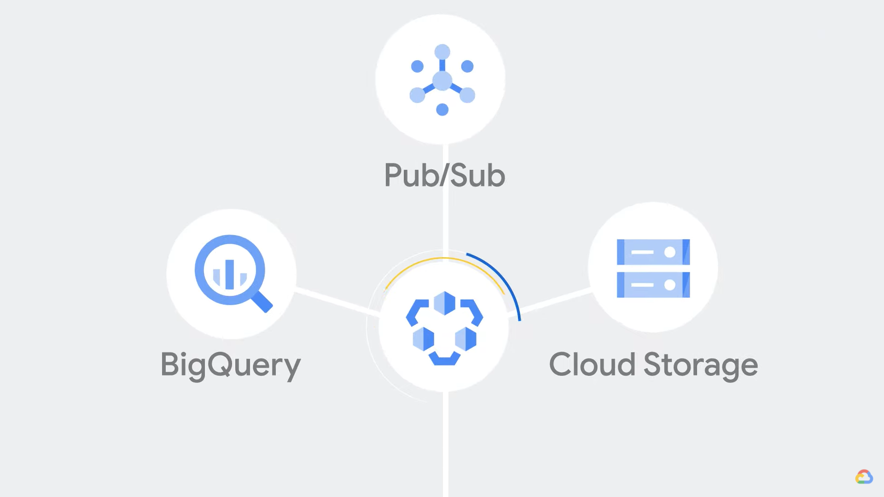
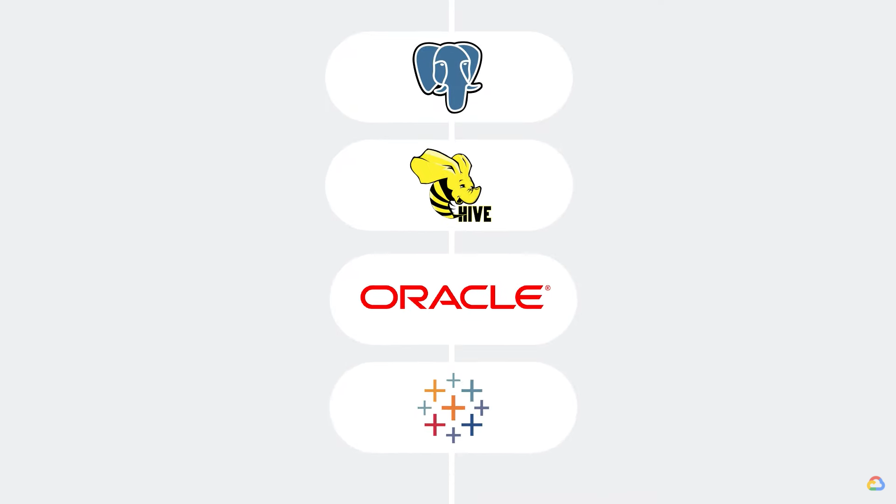
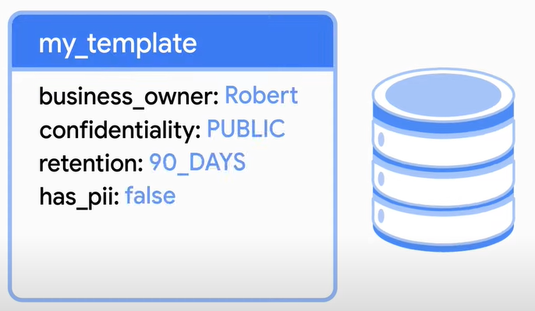
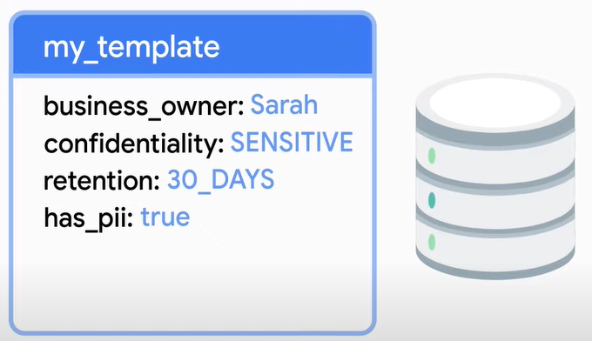
Discover : simple UI / getting access
Manage : classification / protect PII
Understand : structured schema / security
Non-GCP data assets
Notes:
Data Owner, Quality, tag, classification

Slide 12

Big Query
Query streaming data in real-time
Access data and share insights with ease
Protect data and operate with trust
Notes:
使用SQL處裡大量資料，並內建ML，不需要移動資料。
存取資料快速，也能透過其他商業工具(BI)製作報表。
99.99%的運作時間，加密機制保護資料

Slide 13




Pub / Sub
Reliability improvement
Logging to multipue systems
Distributing event notifications
Notes:
可靠性提高
將日誌寫入監視系統，數據庫中以供以後查詢
分發事件通知

Slide 14

Cloud Storage
Storage any other file formats
Encryption
Grant permissions
Notes:
Bring your own encryption key:
CMEK : Customer Managed
CSEK : Customer Supplied

Slide 15

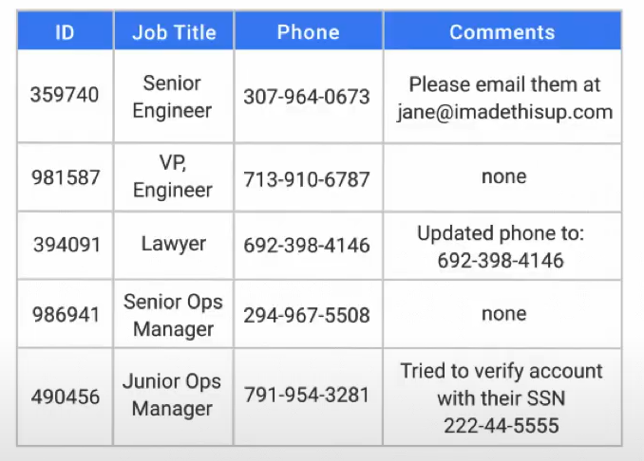
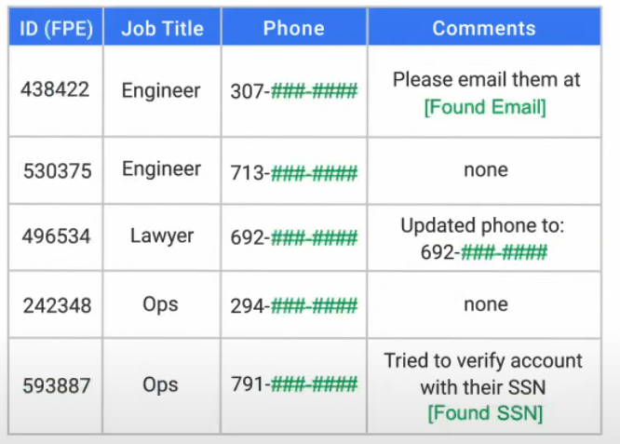
Data Loss Prevention (DLP)

Slide 16
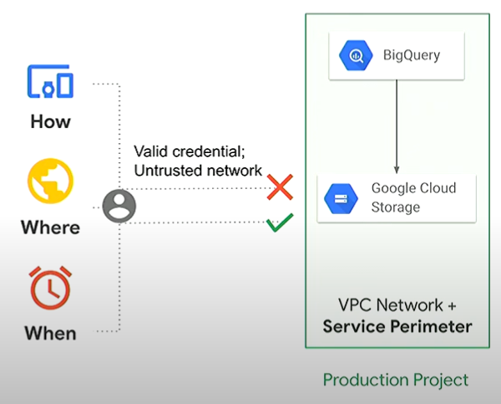
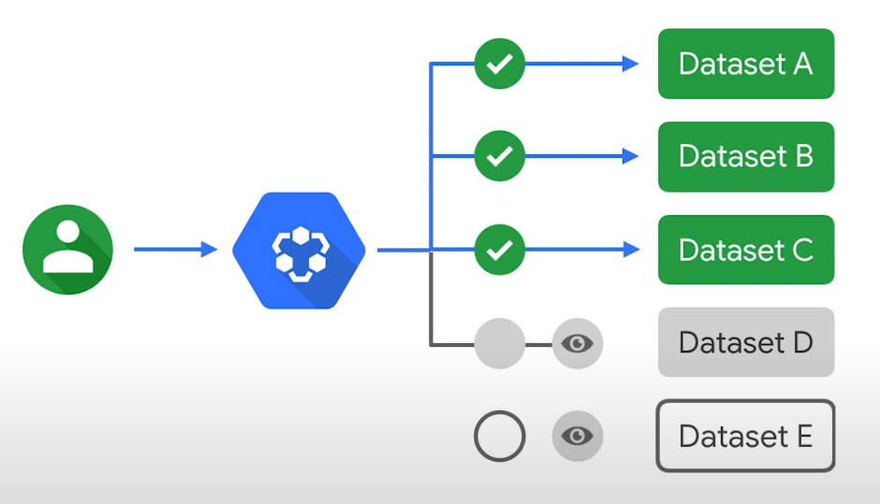
Metadata access governed by
Identity and Access Management (IAM)
VPC Service Controls perimeters
Permission
Role
Notes:
減輕數據洩漏的風險，可以保護指定的資源或是數據

Slide 17
Our Data Catalog

Slide 18
Ingestion
Searching
RDB
Hbase
Cassandra
Data Owner
Data Quality
DAO API
SDM Portal
Security
Visualization
A&A
Invalid IP
Data Flow
DAO Usage

